Slide 1
6 Word Memoir

Slide 2
Do Now
Take three minutes and free write about key elements of your life. What is most important to you? What do these things tell you about yourself? You can focus on one thing or choose multiple items.
Examples:
a family pet
a first love
playing a sport
a first time losing something
Write about anything that makes you, YOU.

Slide 3
Peer
Read a neighbor’s response.
You must actively and take notes on what they said.
Note words that pop out to you with circles or underlines.
Take 3 minutes to do this.

Slide 4
Back to the interviewee
Look over what words your peer circled. Do you agree?
Use this to cull words for your six word memoir.
But first we must ask a question...

Slide 5
What is a Memoir
A memoir is French for “memory.” It is a style of writing an autobiographical account of one’s personal life and experience.
How is this different from a biography or an autobiography?

Slide 6
Write this down.
Biography - an account of someone's life written by someone else, with complete factual details.
Autobiography - an account of someone’s life written by themselves. This genre focuses on the chronology of the writer’s entire life.
Memoir -
What makes a memoir unique is the author must be alive and is writing it from memory. Memoirs are not a factual account of the author's life from birth to present. It focuses on a specific aspect on the author’s life.

Slide 7
A 6 Word Memoir?
It can be six independent words:
Family. Love. Action. Connecting. Giving back.
You can tell a story.
“For sale: baby shoes, never worn.”
WORD CHOICE IS IMPORTANT.

Slide 8
Examples
Life is peace, it is fun.
Break down my wall, discover me.
Death’s a promise of another journey.
Drawing is my airplane to imagination
Stress makes my tics go crazy.
Lost and found. Uneasy days.

Slide 9
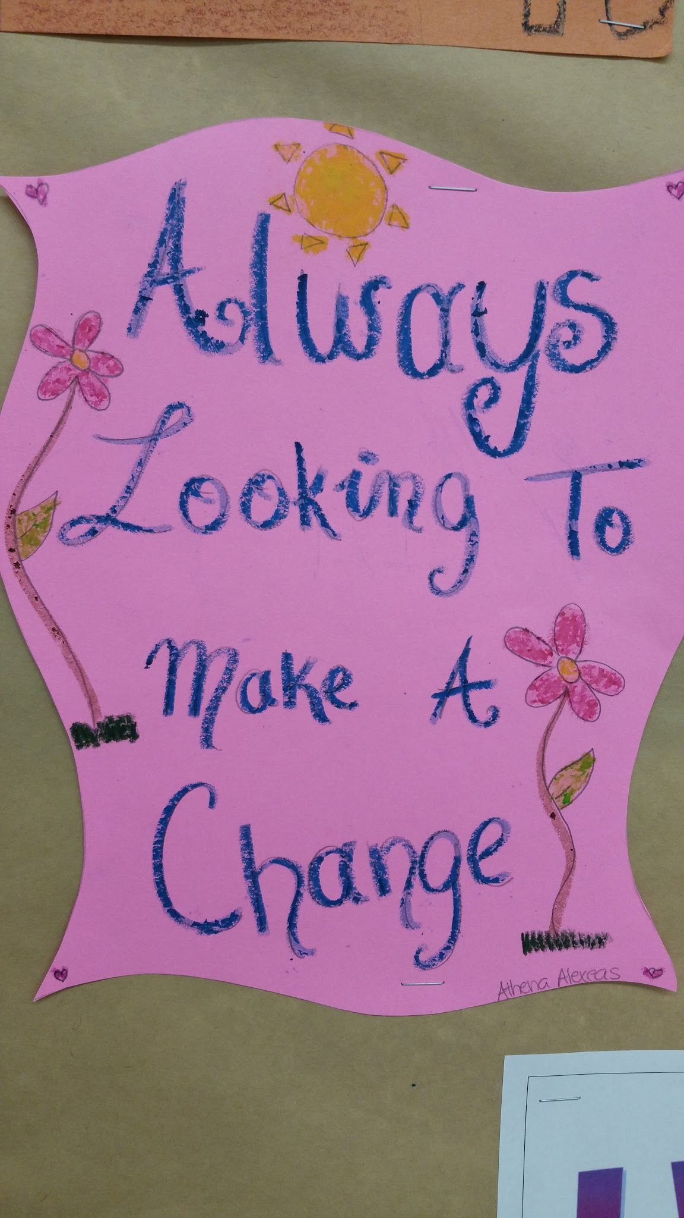
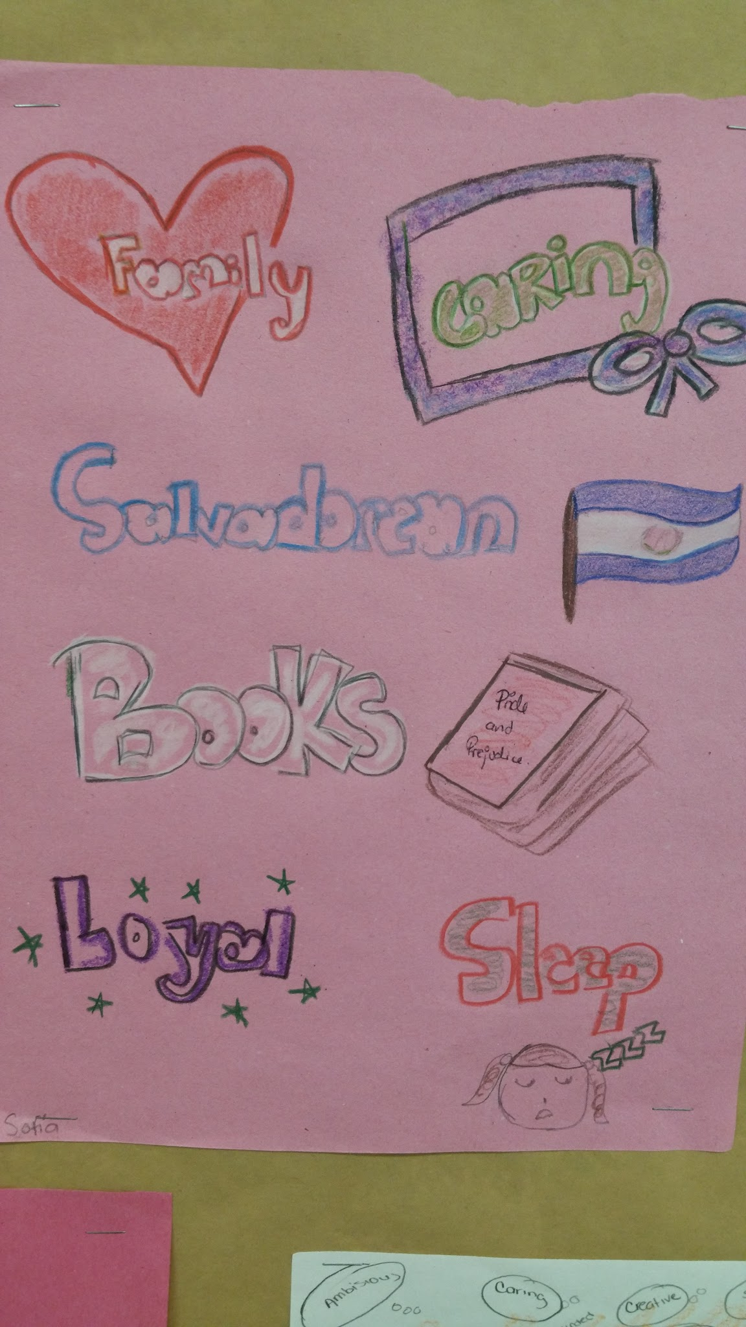
Student examples

